Slide 1
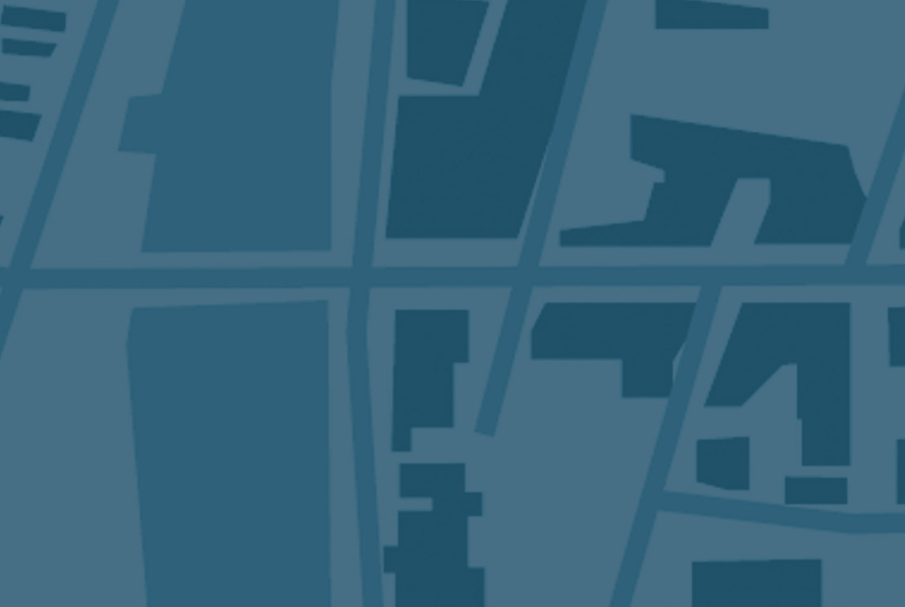
What is Scenario Planning?
MPO/COG Annual Meeting
Columbia, SC
Jessica Hekter
FHWA-SC
Notes:
SLIDE 1 – WELCOME
Good morning, and thank you all for attending today’s workshop.
My name is Jessica Hekter and I am the Planning, AQ and ROW Programs Manager for the SC Division of FHWA.
This morning we are going to talk for a very short time about what Scenario Planning is and then we are going to learn from three MPOsCOGs have utilized Scenario Planning in their regions.

Slide 2
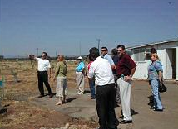
What is Scenario Planning?
Scenario planning:
  Creates multiple plausible stories about what the future could be.
  Develops a common understanding of issues and driving forces of change that affect transportation.
  Helps assess and prepare for possible future conditions.
Notes:
WHAT IS SCENARIO PLANNING
So what is scenario planning?
Scenario planning has been defined in many different ways. In fact, it was originally used in a military context and then was adopted by businesses, government, and non-government organizations.
The application of scenario planning to address transportation and land use emerged over time, with early efforts beginning in the 1960s. Over time, the application of transportation scenario planning has become much more common.
Scenario planning is a process that can help assess and prepare for possible conditions using multiple plausible stories about the future. Through comparing develops a common understanding of health, economic, environmental, and land use issues, all of which may affect transportation. It identifies the driving forces of changes that affect communities. These forces of changes could include:
Demographics.
Land use patterns.
Climate change.
Economic shifts.
Technological innovations.
Alternative energy use.
Overall, we see scenario planning as an enhancement of, not a replacement for, the traditional transportation planning process. It is a flexible technique that can be adapted for many purposes, scales, and issues, and can be used in many different types of areas.

Slide 3
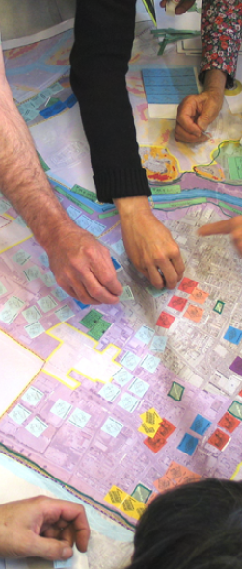
What is Scenario Planning?
Integrates transportation and land use planning.
Helps explain long-term consequences of today’s decisions.
Demonstrates how trade-offs can lead to desired futures.
Actively engages stakeholders.
Similar to visioning and alternatives analysis but:
  Asks “what if…?”
  Compares and assesses future likely land uses.
  Examines interactions between multiple factors and trends.
Notes:
What is Scenario Planning? (Continued)
Many scenario planning processes are long – 12 to 18 months - with extensive public involvement and quantitative analysis of scenarios. Many of these processes lead to either an adopted vision or a long-range plan. However, scenario planning can be applied in a variety of contexts and we want to promote it as a flexible approach.
Across most scenario planning efforts, we typically see several defining features. For example, by exploring how different land use patterns affects transportation networks, the process allows better integration of transportation and land use planning. By comparing scenarios, stakeholders can weigh in to assess what trade-offs are involved in decision-making. Another defining feature of scenario planning is its active involvement of stakeholders, including the public. For instance, the public can participate to help identify key trends affecting the region, help articulate components of scenario alternatives, help assess and compare scenarios, and determine appropriate next steps to encourage the region to move to a future preferred alternative.
A question you may have is: how does scenario planning differ from alternatives analysis or visioning?
Scenario planning does share common features with both. For example, both scenario planning and alternatives analysis focus on comparing and contrasting options and outcomes. In both scenario planning and visioning, stakeholders are engaged to identify future goals and aspirations and use illustrations and visualizations to picture what the future might look like.
However, scenario planning differs from both alternatives analysis & visioning by:
Considering land use - and possibly other factors - as variables, rather than projecting one future assumption. Essentially, scenario planning compares the most likely future land uses and helps determine the best use by tying it to transportation, environmental, social and other variables.
Examining interactions between multiple factors, such land use, transportation, economic issues, and demographic trends, when assessing possible future outcomes.
Exploring trade-offs and how these can lead to the desired future.
Emphasizing active involvement from a broad group of stakeholders to achieve consensus on a shared future vision and action plan.

Slide 4
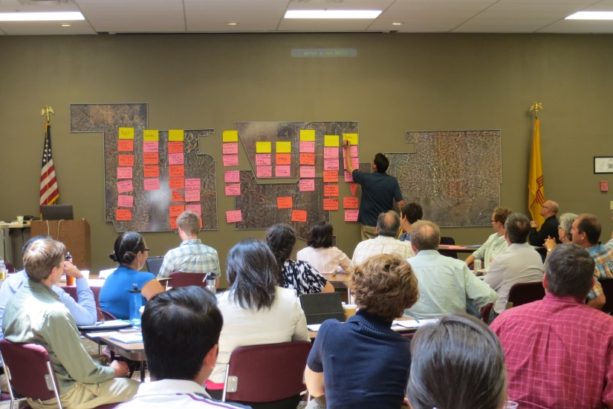
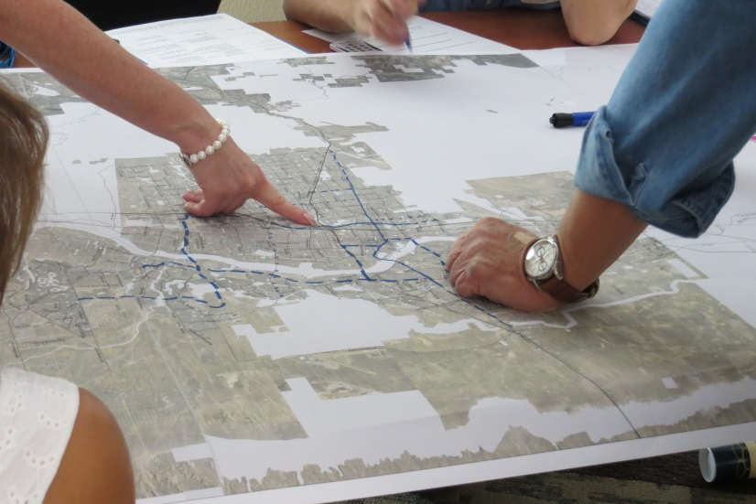
Benefits of Scenario Planning
Connections to Integrated Planning
  More strategic transportation and land use decision-making.
  Active stakeholder involvement.
  Dialogue among transportation and land use professionals, and members of the community.
Notes:
SLIDE 5 – Scenario Planning Connections (Brian Betlyon)
Scenario planning also has connections to integrated planning and performance-based planning:
Scenario planning can help agencies and stakeholders compare transportation choices and consequences, allowing for better, more informed decisions.
Scenario planning can promote greater interest from a broader set of the population by engaging stakeholders in process of creating and evaluating alternative future. scenario planning with visualization tools, such as maps or graphics, could eliminate the need for technical jargon and facilitates people’s understanding of how transportation and land use interact. It can also help the public better understand planning challenges, encourage enthusiasm and interest from local elected officials, and allows the public and others to weigh in on desired actions and policies.
In engaging stakeholders in discussion about alternative futures, it can promote dialogue among transportation and land use professions, and other members of the community.

Slide 5
How Do FHWA and FTA Support
Scenario Planning?
The Scenario Planning Program:
  Sponsors scenario planning workshops and webinars.
  Provides guidance and assistance to agencies using scenario planning.
  Collects and shares innovative practices and lessons learned through case studies and research.
  Provides information on tools and resources.
  FHWA Scenario Planning Program Website:
  www.fhwa.dot.gov/planning/scenario_and_visualization/scenario_planning/
Notes:
How Does FHWA Support Scenario Planning?
FHWA supports scenario planning through its Scenario Planning Program. This program was initially developed in response to SAFETEA-LU in 2004, and has since been strengthened in MAP-21 and continued with the FAST ACT, however it is not REQUIRED. It is promoted by FHWA as a best practice
As part of the SP program:
Sponsors workshops around the country. In fact, we have sponsored more than 25 workshops in more than 20 states since the program began.
Sponsors webinars on SP topics of interest.
Provide guidance and assistance to agencies using scenario planning, and collect and share best practices and lessons learned through workshop reports and research.
Provide information on SP tools and resources.
The primary venue for communicating all information about our SP program is through the website – the link is shown on the screen. We encourage you all to visit the website to learn more.

Slide 6
Scenario Planning Examples
John Orr
Manager of the Transportation Access and Mobility Division
Atlanta Regional Commission
Rita Marocima-Black
Transportation Planner
Champaign County Regional Planning Commission
Kathryn Basha
Planning Director
Berkley, Charleston, Dorechester COG
Notes:
Now that you have a brief background on what Scenario Planning is in theory, lets get to our practitioners.
Today we are delighted to have Jon, Rita, and Kathryn share their scenario planning examples with us.

